Slide 1
AR APP FOR INTERACTIVE STUDIES
An augmented reality to change the future

Slide 2
What is Augmented Reality (AR)?
Augmented Reality is a technology that let’s people superimpose digital content over a real world environment. This digital content includes images, sounds and texts.
An Augmented Reality application will implement visual, auditory, and other sensory information into the world to enhance your experience.

Slide 3
Why do we need AR ?
Augmented Reality (AR) enables digital information to be superimposed and integrated into our physical environment. With many of us now at home during a global pandemic, AR is a tool that can help us transform our immediate surroundings into learning, work and entertainment spaces.

Slide 4
Nintendo’s ‘Pokemon Go’
AR got a lot of attention in 2016 with around 65 million users when the game Pokémon Go made it possible to interact with Pokémon superimposed on the world via a smartphone screen. This mobile app gave users the ability to catch all types of virtual Pokémon in a real-world environment with superimposed overlays.
At its peak, the game kept plenty of people consistently engaged. It's a great example of how AR can blend the virtual and real worlds together in a seamless way.

Slide 5
Objective
We aimed to develop an augmented reality based app which can be used by the students with their traditional textbooks. Our app will help the students to visualize 3-D representation of the entity they are learning about.

Slide 6
Theory
Our app is made using Unity3d Game Engine. We used Vuforia SDK for Image Processing and Detection. This app allowed us to understand the concepts easily and way better than just seeing the 2d pictorial format of the subject. Basic requirement of the app is an Android phone or tablet with a camera on which our app will run.

Slide 7
Implementation
Android phone with camera
User
Send target data
Draw 3D object
AR software
Request for 3D object
Send 3D object data
3D object database

Slide 8
APPLICATIONS
1. Complete AR experience for the students to help them visualize things in real life.
2. Completely User-Friendly and Realistic User interface.
3. Easy to visualize and make things living.
4. Making learning much Entertaining and Realistic than ever before.

Slide 9
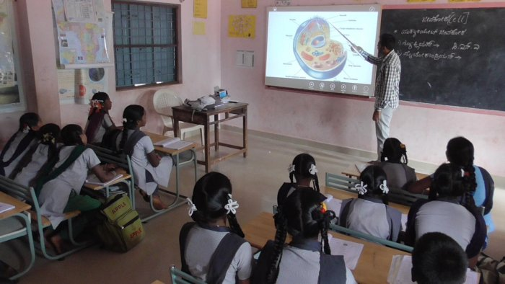
Teaching through visual 3D images on a 2D plane

Slide 10
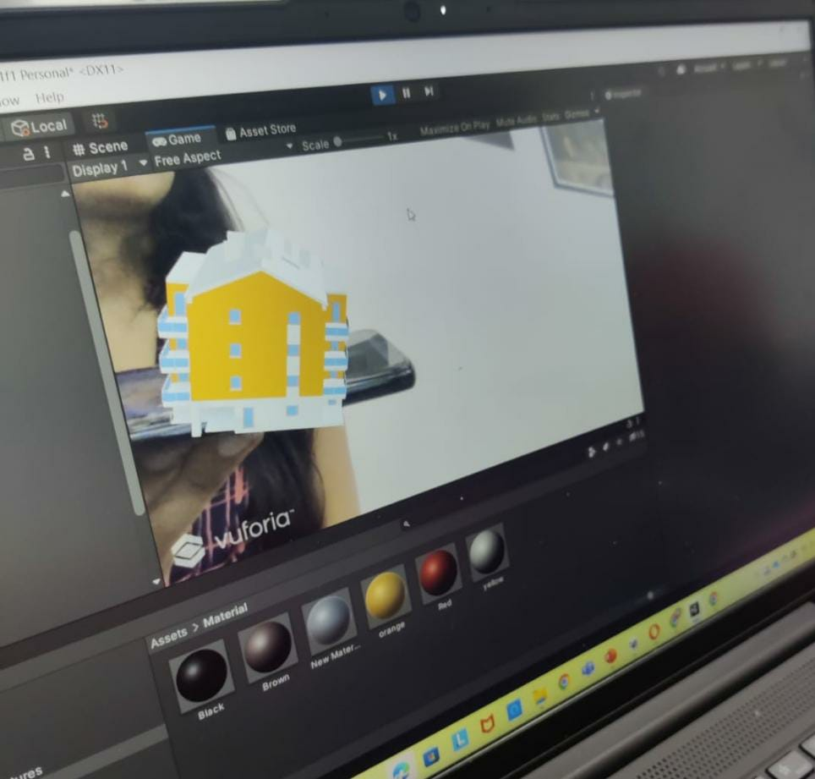
Teaching through 3D models which make the studies more interactive and improves understanding

Slide 11
ADVANTAGES OF OUR APP
The AR app for interactive studies is highly interactive in nature and operates simultaneously with real time environment.
It reduces the gap between real world and virtual world.
It enhances perceptions and interactions.
It can be applied to part of practicals as it makes things memorable and eye catching.

Slide 12
What we aim and the future of this app
We want to increase our database and scale our app in particular fields like human anatomy.
We also want to incorporate machine and deep learning so that different images of same object can be detected.
Scaling our app in educational field.

Slide 13
Team members
Anushka Gupta , ECE
Mitali Saraswat, ECE
Apoorva Bansal, ECE
Janhavi Sukhadeve, ECE
Priyanshu Gupta, EE

Slide 14
THANKYOU!

